Slide 1
Multiple hypothesis testing
October 25, 2024 | CMDB Quantitative Biology Lab

Slide 2
Learning Objectives
Define different types of errors
Contrast the family-wise error rate and the false discovery rate
Implement FWER and FDR correction on statistical results
Apply these concepts to the problem of differential expression analysis with RNA-seq data

Slide 3
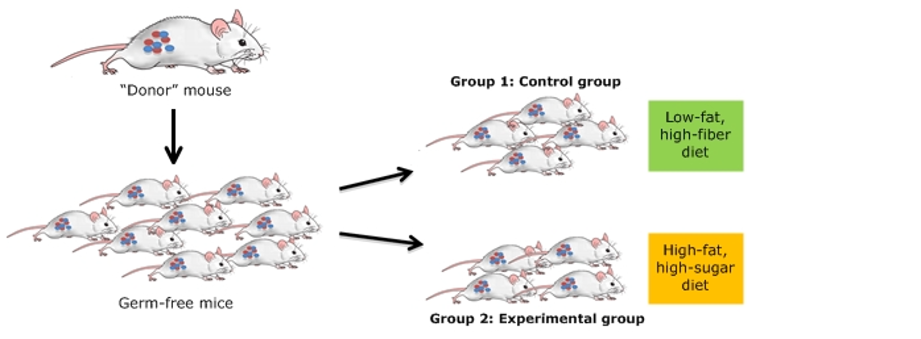
Many tests, many errors
Example: differential expression analysis

Slide 4
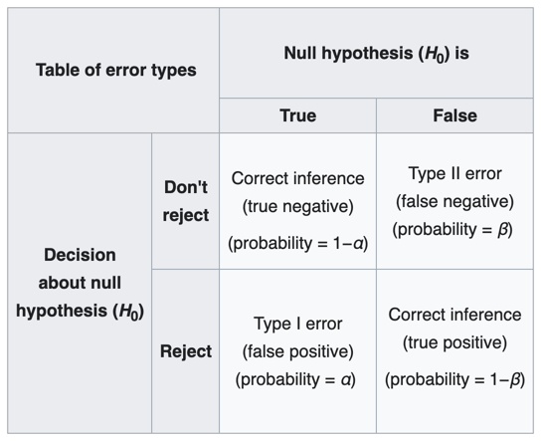
Different types of errors
Notes:
This table is useful for conceptualizing different outcomes of a hypothesis test. The top left and bottom right portions of this 2 x 2 grid are what we generally strive for in our experiments--to reject the null hypothesis when the null hypothesis is false, but not when the null hypothesis is true. Meanwhile, if we fail to reject the null hypothesis when the null hypothesis is false, we call this a false negative, or type II error.
In contrast, if we reject the null hypothesis when the null hypothesis is true, we call this a false positive or type I error. Alpha is defined as the probability of type I error (false positive).
When conducting hypothesis testing, we often want to control the level of alpha. When we conduct a single statistical test, we often want to ask if our p-value is smaller than an alpha of 0.05. Of course, this is arbitrary, and we can choose an alpha that is appropriate for our problem.

Slide 5
Different types of errors
Notes:
This table is useful for conceptualizing different outcomes of a hypothesis test. The top left and bottom right portions of this 2 x 2 grid are what we generally strive for in our experiments--to reject the null hypothesis when the null hypothesis is false, but not when the null hypothesis is true. Meanwhile, if we fail to reject the null hypothesis when the null hypothesis is false, we call this a false negative, or type II error.
In contrast, if we reject the null hypothesis when the null hypothesis is true, we call this a false positive or type I error. Alpha is defined as the probability of type I error (false positive).
When conducting hypothesis testing, we often want to control the level of alpha. When we conduct a single statistical test, we often want to ask if our p-value is smaller than an alpha of 0.05. Of course, this is arbitrary, and we can choose an alpha that is appropriate for our problem.

Slide 6
Different types of errors
Notes:
This table is useful for conceptualizing different outcomes of a hypothesis test. The top left and bottom right portions of this 2 x 2 grid are what we generally strive for in our experiments--to reject the null hypothesis when the null hypothesis is false, but not when the null hypothesis is true. Meanwhile, if we fail to reject the null hypothesis when the null hypothesis is false, we call this a false negative, or type II error.
In contrast, if we reject the null hypothesis when the null hypothesis is true, we call this a false positive or type I error. Alpha is defined as the probability of type I error (false positive).
When conducting hypothesis testing, we often want to control the level of alpha. When we conduct a single statistical test, we often want to ask if our p-value is smaller than an alpha of 0.05. Of course, this is arbitrary, and we can choose an alpha that is appropriate for our problem.

Slide 7
Different types of errors
Notes:
This table is useful for conceptualizing different outcomes of a hypothesis test. The top left and bottom right portions of this 2 x 2 grid are what we generally strive for in our experiments--to reject the null hypothesis when the null hypothesis is false, but not when the null hypothesis is true. Meanwhile, if we fail to reject the null hypothesis when the null hypothesis is false, we call this a false negative, or type II error.
In contrast, if we reject the null hypothesis when the null hypothesis is true, we call this a false positive or type I error. Alpha is defined as the probability of type I error (false positive).
When conducting hypothesis testing, we often want to control the level of alpha. When we conduct a single statistical test, we often want to ask if our p-value is smaller than an alpha of 0.05. Of course, this is arbitrary, and we can choose an alpha that is appropriate for our problem.

Slide 8
Many tests, many errors
Example: differential expression analysis

Slide 9
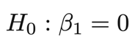
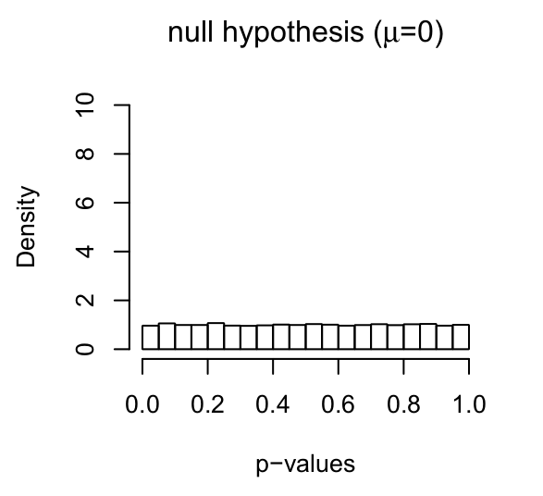
Notes:
Even for data generated under the null hypothesis, we expect a uniform distribution of p-values. So for a million statistical tests, you should expect alpha (0.05) times 1M = 50,000 significant hits just by chance.

Slide 10
Approach 1: controlling the family-wise error rate
The family-wise error rate (FWER) is the probability of making any Type 1 errors at all.
Examples of FWER correction include Bonferroni correction:
Test each hypothesis at a level α / m, where m is the number of hypothesis tests and α is the desired probability of making any Type 1 errors.
Notes:
There are two basic approaches to controlling the rate of Type I error in the context of multiple testing. The first attempts to control the family-wise error rate, or the probability of making ANY type I errors at all.
An example of FWER correction that you may have heard of is Bonferroni correction. To apply a bonferroni correction, you simply test each hypothesis at a level of alpha / m, where m is the number of hypotheses and alpha is the desired level of type I errors.

Slide 11
Approach 2: controlling the false discovery rate
The false discovery rate (FDR) is the expected proportion of Type 1 errors out of all rejections of the null hypothesis.
Common examples of FDR correction include the Benjamini-Hochberg procedure, as well as Storey’s q-value approach.
Notes:
The second basic approach to addressing type I errors during multiple testing is by controlling what is called the false discovery rate. The false discovery rate is the expected proportion of type I errors out of all of the rejections the null hypothesis. So if alpha is 0.05, we are saying that we will allow up to 5% false positives among the test we call significant.
A common approach to FDR correction is the Benjamini-Hochberg procedure. We won’t go over it in detail this afternoon, but the basic algorithm is described here and may be covered later in quant lab.

Slide 12
Testing for expression differences (differential expression)

Slide 13
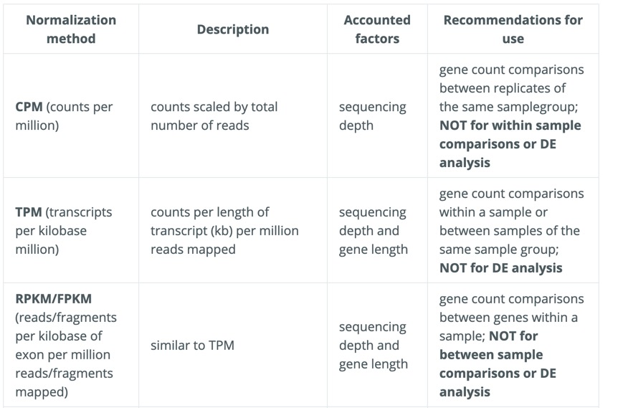
Which normalization is most appropriate for my analysis?

Slide 14
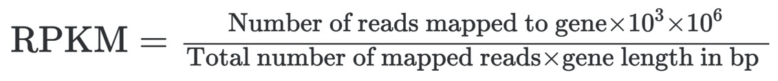
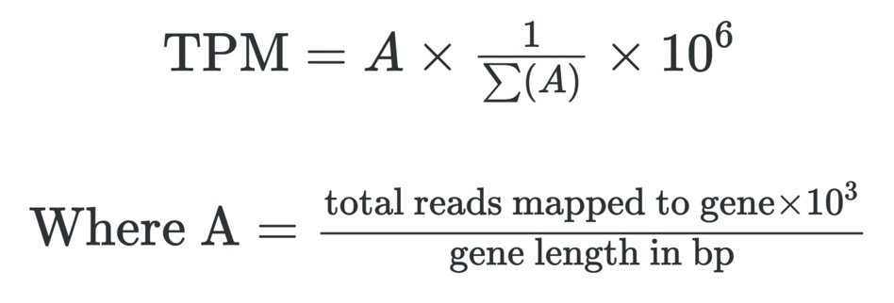
Which normalization is most appropriate for my analysis?

Slide 15
Which normalization should be used for DE analysis?
DESeq2 ”Median of Ratios”
No need to account for gene length (since the comparisons are for one given gene at a time)
For each gene, create a pseudo-reference sample (geometric mean count across samples)
For each sample, compare its expression to the reference as a ratio.
For each sample, take the median of those ratios across genes to get a ”normalization size factor” for that sample.
These size factors are used as “offsets” (i.e., a co-variate with a known value that we do not estimate) in the downstream test for differential expression (linear regression model).

Slide 16
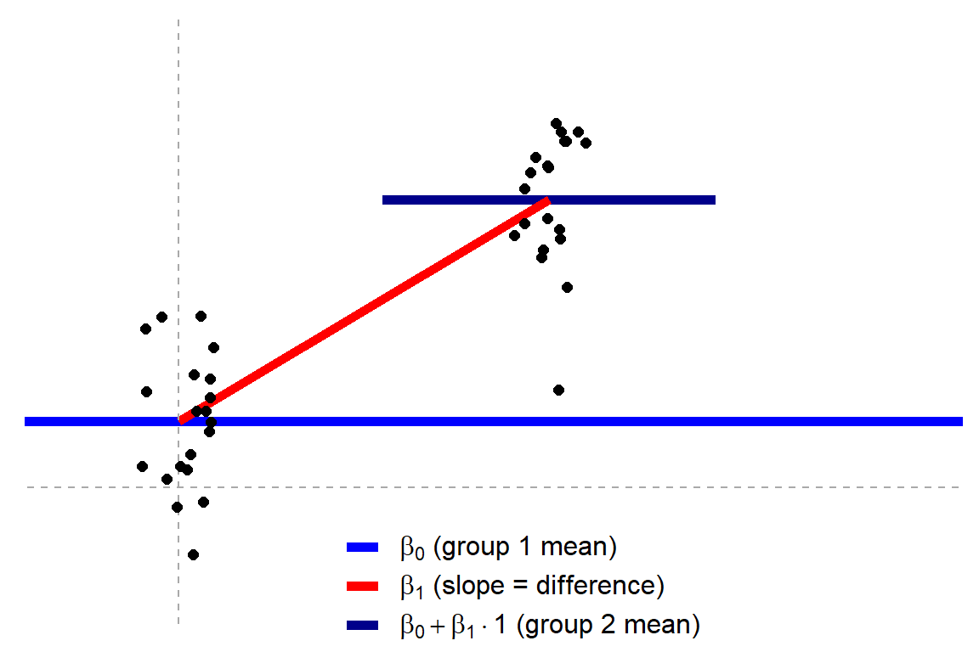
Independent t-test?
For each gene…
𝑦 = 𝛽₀ +𝛽₁𝑥_{i}
where x_{i} is an indicator variable (0 or 1) that tells us to which group the data point belongs.
Jonas Kristoffer Lindeløv: https://lindeloev.github.io/tests-as-linear/
Notes:
For example, an independent t-test is just simple linear regression model, but with a single binary predictor variable (also called an indicator variable or dummy variable). The indicator variable takes the value zero or one, to indicate to which group each point belongs. We then test whether the slope (beta-1) is significantly different than the null hypothesis of zero.

Slide 17
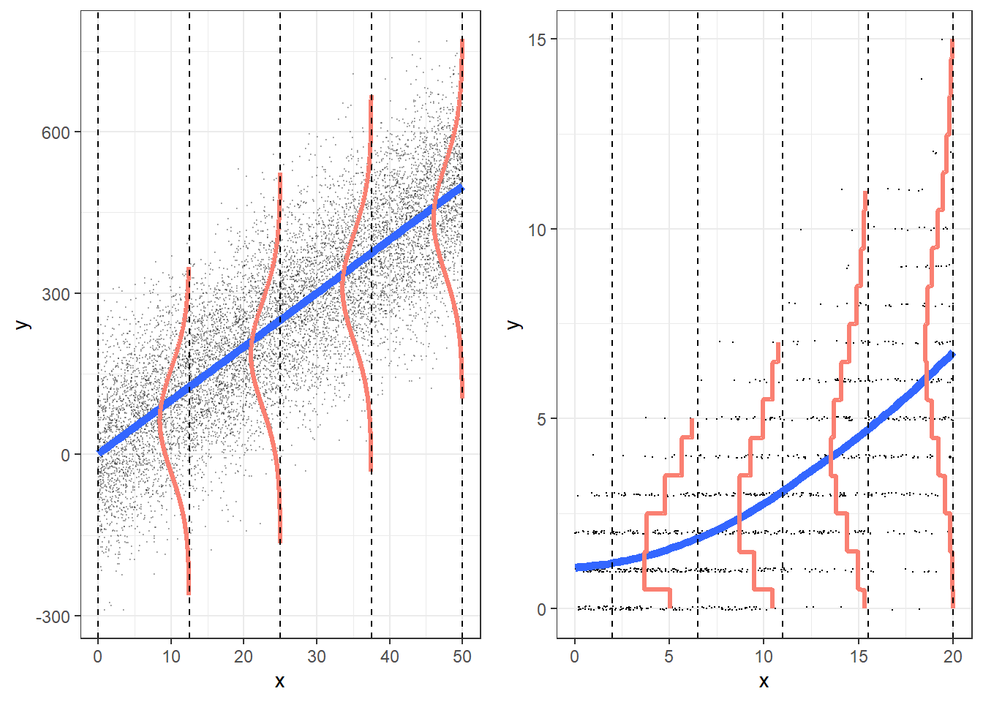
A better approach is to model the read counts…
Linear regression
Poisson regression
Notes:
A better way of modeling gene expression is to actually model the counts of reads aligned to the gene in each sample. OLS regression is not appropriate for count data, which 1) cannot be negative, 2) have a different shaped distribution.
Counts can be modeled with Poisson regression, however, Poisson models assume that the mean and variance are equal.

Slide 18
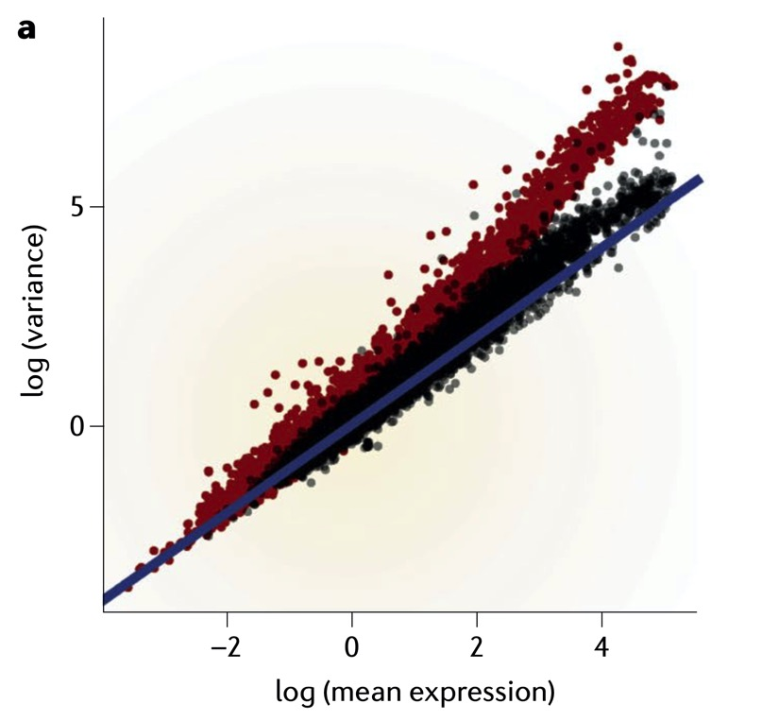
But there is more variance than Poisson assumes
Technical + biological variability
Technical variability alone
Poisson expectation
σ² = μ
Notes:
black is technical variability alone; red includes variability across samples; blue is Poisson expectation

Slide 19
Negative binomial models allow for extra dispersion
Negative binomial model
σ² = μ + φμ²
Technical + biological variability
Technical variability alone
Poisson expectation
σ² = μ
Notes:
black is technical variability alone; red includes variability across samples; blue is Poisson expectation

Slide 20
How is the dispersion parameter (φ) estimated?
For a given gene…
Φ = (σ / μ)²
Notes:
DESeq2 estimates gene-level dispersion parameters by examining the mean-dispersion relationship and sharing information across genes with similar mean expression

Slide 21
How is the dispersion parameter (φ) estimated?
DESeq2 “shrinks” these dispersion estimates
Notes:
DESeq2 estimates gene-level dispersion parameters by examining the mean-dispersion relationship and sharing information across genes with similar mean expression

Slide 22
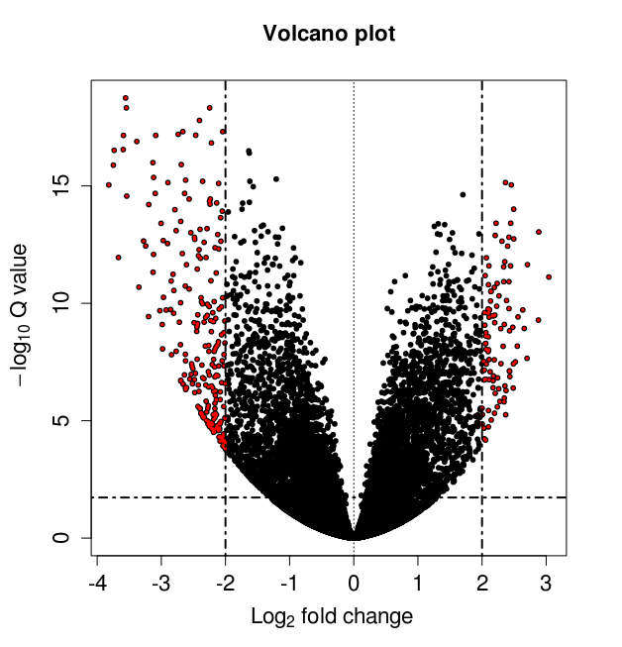
Visualizing your results (Volcano plot)

